Slide 1
Material Properties and Effects of Processing

Slide 2
Mechanical properties
Density
  Density is the mass in kilograms, contained in a cubic metre of amaterial or substance.
Tensile strength
  The tensile strength of a material is a measure of its ability to withstand tensile forces
Ductility
  The ductility of a material is a measure of the amount by which it can bedrawn out in tension before it fractures.

Slide 3
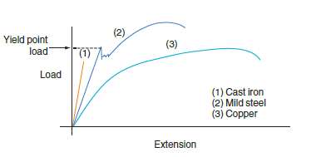
Load Vs. Extension Graph

Slide 4

Tensile Test Specimen

Slide 5
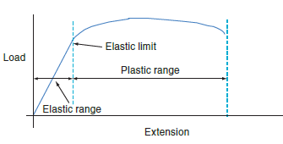
Elastic and Plastic Deformation

Slide 6
Brittleness
  Brittle materials tend to fail within the elastic range, or very early in the plastic range, before very much deformation has taken place.
Elasticity
  The elasticity of a material is a measure of its ability to withstand elastic deformation.
Malleability
  malleability is the ability of a material to be deformed or spread in different directions

Slide 7
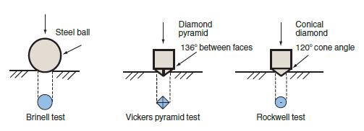
Hardness
  Hardness is the ability of a material to withstand wear and abrasion.
Indentation Tests

Slide 8
Brinell hardness test
http://www.youtube.com/watch?v=RJXJpeH78iU
Vicker test
http://www.youtube.com/watch?v=7Z90OZ7C2jI&list=PLYMPld7E7shysxdUoA-K1FQp50I04Ng2g
Rockwell test
http://www.youtube.com/watch?v=439POmkcG-E

Slide 9
Toughness
  Toughness is the ability of a material to withstand impact and shock loading.
  The standard tests for toughness are the Izod impact test and the Charpy test.

Slide 10
Izod Impact Test
http://www.youtube.com/watch?v=jIsEKtA323A
Charpy Impact Test
http://www.youtube.com/watch?v=tpGhqQvftAo

Slide 11
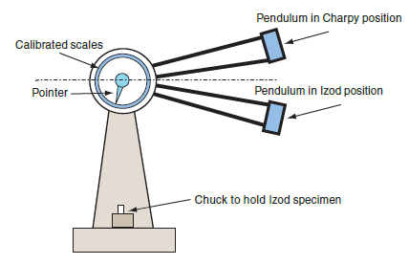
Izod/Charpy Impact Tester

Slide 12
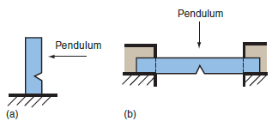
(a) Izod and (b) Charpy impact Test Specimens

Slide 13

Thermal properties
Expansivity
  When metals are heated they generally expand.
  Thermal expansivity is a measure of the effect of temperature change on the dimensions of a material when it is heated.

Slide 14
Thermal conductivity
  The thermal conductivity of a material is defined as the amount of heat energy per second that will pass through a 1 m cube of the material when the difference in temperature between opposite faces is 1°C. It is given the symbol k.

Slide 15
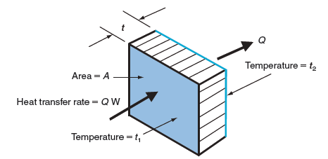


Conduction of Heat Energy

Slide 16

Electrical and magnetic properties
Resistivity
Temperature coefficient of resistance
Permeability (µ_{r})
  Permeability is a measure of a material ’ s ability to intensify the magnetic field produced by a current-carrying coil
Permittivity
  Permittivity is a measure of a material ’ s ability to intensify an electric field such as that produced between the plates of a capacitor.
  The relative permittivity r gives a measure of the increased field intensity when a dielectric is present. For an air space, ε_{r} = 1.0006, for paper, ε_{r} = 2–2.5, for mica, which is a ceramic, ε_{r} = 3–7.

Slide 17
Durability
Corrosion resistance
Solvent resistance
Radiation resistance

