Slide 1
Modes of Failure

Slide 2
Outline
Failure
  Elastic Failure
  Brittle or cleavage failure
Creep
Fatigue
Degradation
  Corrosion
  Solvent Attack
  Radiation Damage and Aging

Slide 3
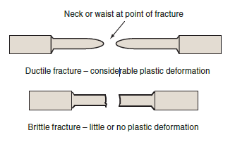
Elastic Failure
Elastic Failure : When the load on a ductile material exceeds the elastic limit, it becomes permanently deformed

Slide 4
Brittle or Cleavage Fracture
Brittle materials, such as cast iron, very often fail in the elastic range with the brittle types of fracture
Brittle or cleavage fractures usually have a granular appearance due to the reflection of light from the individual grains.
Grain growth occur at high temperature, too large a grain size can affect the strength of a material and make it brittle.
Brittle fracture, which is also known as cleavage fracture, is more prevalent in materials with BCC and HCP crystal lattice structures.

Slide 5
Why component fail?
Static loads can be hard to predict and dynamic loads on the component parts of machinery, motor vehicles and aircraft are very difficult to analyse.
A complex stress system Combinations of direct loading, shearing, bending and twisting )is then said to exist, the resultant of which may exceed the predicted working stress and lead to failure.
Presence of stress concentrations in a components (occur at sharp internal corners, holes, fixing points and welds.)
Stress raisers , where the stress may exceed that at which failure occurs.
These kinds of failure are usually detected at the prototype stage and the design modified to prevent them occurring.

Slide 6
How to avoid these failure?
Use suitable factor of safety in designing components. As a general rule, factor of safety of at least 2 should be employed on static structures.

Slide 7
Does ductile material undergo brittle failure?
The plastic deformation which precedes a ductile fracture takes a finite amount of time to take place. If a load in excess of that which will cause fracture is suddenly applied, as with an impact load, there will be insufficient time for plastic deformation to take place and a brittle form
of fracture may occur.
This can be observed during an Izod or Charpy impact test where an otherwise ductile material is suddenly fractured by an impact load.
Some metals which exhibit ductile behaviour under normal conditions become very brittle at low temperatures. The temperature at which the change occurs is called the transition temperature . Mild steel becomes brittle at around 0°C.

Slide 8
Creep
Creep is a form of plastic deformation which takes place over a period of time at stress levels which may be well below the yield stress of a material.
As a general rule, there will be little or no creep at temperatures below 0.4 T , where T is the melting point of the material measured on the kelvin scale (e.g. mild steel, T =1500°C)
With the more common engineering metals, creep is a problem encountered at sustained high temperatures such as those found in steam and gas turbine plant.
Under extreme conditions it can eventually lead to failure.

Slide 9
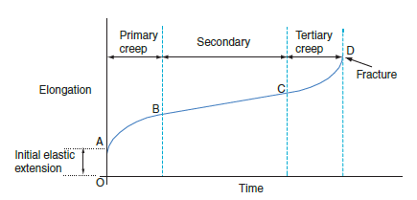
Creep
Creep Vs Time Graph

Slide 10
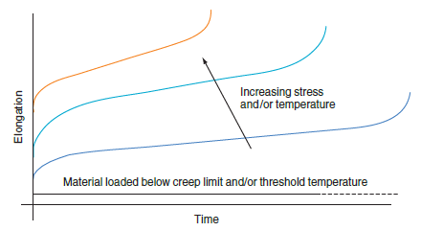
Creep
Effect of increasing load and Temperature

Slide 11
Creep formation
Study of the nature of creep suggests that the plastic deformation is partly due to slipping of the planes of atoms in the grains and partly due to viscous flow at the grain boundaries.
The atoms tend to pile up in an irregular fashion at the grain boundaries which would normally lead to work hardening.
The high temperatures however have a relieving effect, and the smaller the grains the greater is the viscous flow at the grain boundaries.

Slide 12
Creep Resistance
Creep resistance can be increased in two ways.
The first is to introduce alloying elements which reduce slipping within the grains.
The second is to have as course a grain structure as possible, bearing in mind that this can
lead to increased brittleness at normal temperatures.
Many creep resistant materials have been developed over the last fifty years, in particular the nimonic series of alloys which have been widely used in gas turbines.

Slide 13
Fatigue
Fatigue failure is a phenomenon which can occur in components which are subjected to cyclic loading.
That is to say that they are repeatedly subjected to fluctuating or alternating stresses.
Typical examples are the suspension units on motor vehicles and the connecting rods and crankshafts in internal combustion engines.
The alternating stresses may be well below the elastic limit stress, and the material would be able to carry a static load of the same magnitude indefinitely
Failure usually starts with a small crack which grows steadily with time.

Slide 14
Fatigue Limit
In ferrous metals there is a certain stress level below which fatigue failure will not occur no matter how many stress reversals take place.
This is called the fatigue limit and is given the symbol S_{D}
As a general rule for steels, the fatigue limit is about one-half of the UTS of the material.
The higher the stress above this value, the fewer will be the number of reversals or stress cycles before failure occurs

Slide 15
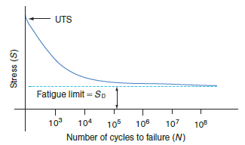
S-N Graph

Slide 16
Effect of extrusions and Intrusions
Fatigue cracks are observed to spread from points of stress concentration.
Cyclic loading at stress levels above S_{D} produces slip in the planes of atoms in the grains of a material.
This results in the appearance of small extrusions and intrusions on the surface of an otherwise smooth material
Although the intrusions are very small, they act as stress raisers from which a fatigue crack can spread.
Discuss the effect of other stress raisers (sharp internal corners, tool marks, quench crack, etc)

Slide 17
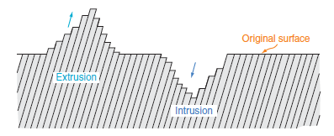
Intrusion and Extrusion due to local slip

Slide 18
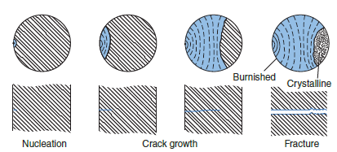
Fatigue Fracture Appearance

Slide 19
The fracture surfaces of a fatigue failure have a characteristic appearance as shown in the figure.
As the fatigue crack spreads, its two sides rub together under the action of the cyclic loading.
This gives them a burnished, mother-of-pearl appearance.
Eventually the material can no longer carry the load and fractures.
The remainder of the surface, where fracture has occurred, has a crystalline or granular
appearance

Slide 20
Degradation

Slide 21
Corrosion
Low temperature or ‘ wet ’ corrosion is due to the presence of moisture and results in the formation of red rust.
Red rust is an iron oxide formed by electro-chemical action, in which the moisture acts as an electrolyte.
Adjacent areas of the metal, which have a different composition, such as the alternate layers of ferrite and cementite in the pearlite grains, become the anodes and cathodes.
Corrosion occurs at the anode areas resulting in rust formation.

Slide 22
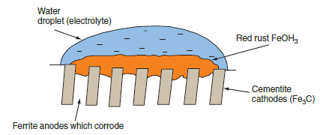
The ferrite layers, which are almost pure iron, become anodes and corrode to form FeOH₃ which is red rust.
Wet corrosion of pearlite grain

Slide 23
Stress Corrosion
The same kind of electrolytic action can occur between adjacent areas which have been cold worked to a different extent.
For the figure showing a fold in a sheet of metal which is more highly stressed than the surrounding areas.
In the presence of moisture, the region in the fold becomes an anode and corrodes.
This kind of electrolytic action is called stress corrosion .
It is the form from which motor vehicle panels can suffer if they are not properly protected.

Slide 24
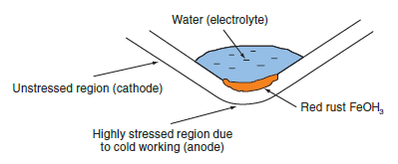
Stress Corrosion

Slide 25
Dry Corrosion
High temperature or ‘ dry ’ corrosion occurs due to a direct chemical reaction between the metal and oxygen in the atmosphere .
It results in the formation of black millscale when the metal is heated for forging or for heat treatment..
Millscale is another form of loose and porous iron oxide whose chemical formula is FeO.

Slide 26
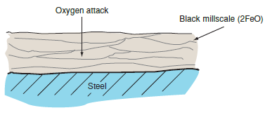
High Temperature Corrosion

Slide 27
Solvent attack
Thermosetting plastics tend to have a high resistance to solvents and it is generally thermoplastics and rubbers which are most vulnerable.
The action of the solvent is to break down the Van der Waal forces and take the polymers into solution.
Industrial solvents used for degreasing and or paint thinners, petrol, fuel oil, lubricating oils and greases can have this effect on some polymers.

Slide 28
Radiation Damage and Aging
The ultraviolet radiation present in sunlight can have a degrading effect on some thermoplastics and rubbers.
It progressively causes oxygen atom cross-links to form between the polymers.
These cause the material to become brittle and can also lead to discolouration.
Ultraviolet lamps and X-rays used in industrial processes can also cause this kind of degradation.
Colouring pigments are often added during the polymer forming process, and this reduces the effect.
The darker colours are the most effective, black being the best of all.

Slide 29
Deterioration of Ceramics
The absorption of rain water into the surface pores can cause deterioration in winter.
When the moisture freezes, it expands and over a period of time it can cause cracking and flaking.
Sulphur from flue and exhaust gases combines with moisture in the atmosphere to
form sulphurous acid which falls as acid rain.
This attacks many types of ceramic building material and in particular natural stone.
The refractory ceramics used to line furnaces, and the ladles for carrying molten metal can suffer from thermal shock if heated too quickly.

