Slide 1
Engineering Material Classification
A presentation document not a presentation

Slide 2
Introduction
There are thousands of materials available for use in engineering applications.
Most materials fall into one of three classes that are based on the atomic bonding forces of a particular material.
These three classifications are metallic, ceramic and polymeric.
Additionally, different materials can be combined to create a composite material.

Slide 3
Introduction
Within each of these classifications, materials are often further organized into groups based on their chemical composition or certain physical or mechanical properties.
Composite materials are often grouped by the types of materials combined or the way the materials are arranged together.

Slide 4
Metals
Ferrous metals and alloys (irons, carbon steels, alloy steels, stainless steels, tool and die steels)
Nonferrous metals and alloys (aluminium, copper, magnesium, nickel, titanium, precious metals, refractory metals, super alloys).

Slide 5
Polymeric
Thermoplastics plastics
Thermoset plastics
Elastomers

Slide 6
Ceramic
Glasses
Glass ceramics
Graphite
Diamond

Slide 7
Composites
Re-inforced plastics
Metal-matrix composites
Ceramic-matrix composites
Sandwich structures
Concrete

Slide 8
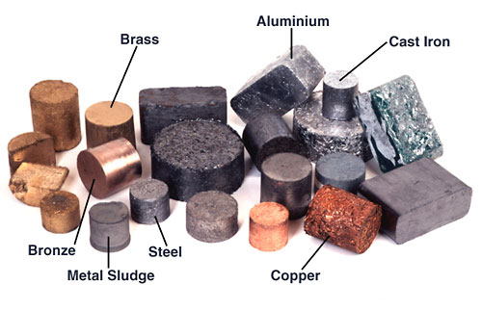
Metals

Slide 9
Metals
Metals account for about two thirds of all the elements and about 24% of the mass of the planet.
Metals have useful properties including strength, ductility, high melting points, thermal and electrical conductivity, and toughness.
From the periodic table, it can be seen that a large number of the elements are classified as being a metal.
A few of the common metals and their typical uses are listed as follows.

Slide 10
Common Metallic Materials
Iron/Steel - Steel alloys are used for strength critical applications .
Aluminium - Aluminium and its alloys are used because they are easy to form, readily available, inexpensive, and recyclable.
Copper - Copper and copper alloys have a number of properties that make them useful, including high electrical and thermal conductivity, high ductility, and good corrosion resistance.

Slide 11
Common Metallic Materials (contd.)
Titanium - Titanium alloys are used for strength in higher temperature (~1000° F) application, when component weight is a concern, or when good corrosion resistance is required.
Nickel - Nickel alloys are used for still higher temperatures (~1500-2000° F) applications or when good corrosion resistance is required.
Refractory materials are used for the highest temperature (> 2000° F) applications.

Slide 12
Metals
The key feature that distinguishes metals from non-metals is their bonding. Metallic materials have free electrons that are free to move easily from one atom to the next. The existence of these free electrons has a number of profound consequences for the properties of metallic materials. For example, metallic materials tend to be good electrical conductors because the free electrons can move around within the metal so freely. More on the structure of metals will be discussed later.

Slide 13
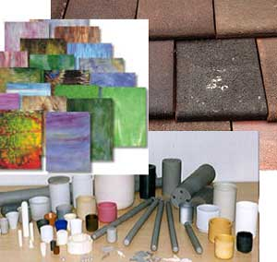
Ceramics

Slide 14
Ceramics
A ceramic has traditionally been defined as “an inorganic, non metallic solid that is prepared from powdered materials, is fabricated into products through the application of heat, and displays such characteristic properties as hardness, strength, low electrical conductivity, and brittleness."
" The word ceramic comes the from Greek word "keramikos", which means "pottery.“
They are typically crystalline in nature and are compounds formed between metallic and non metallic elements such as aluminium and oxygen.

Slide 15
Ceramic Properties
Depending on their method of formation, ceramics can be dense or lightweight.
Typically, they will demonstrate excellent strength and hardness properties; however, they are often brittle in nature.
Ceramics can also be formed to serve as electrically conductive materials or insulators.
Some ceramics, like superconductors, also display magnetic properties.

Slide 16
Ceramic Properties
They are also more resistant to high temperatures and harsh environments than metals and polymers.
Due to ceramic materials wide range of properties, they are used for a multitude of applications.

Slide 17
Ceramic Applications
The broad categories or segments that make up the ceramic industry can be classified as:
Structural clay products (brick, sewer pipe, roofing and wall tile, flue linings, etc.)
Whitewares (dinnerware, floor and wall tile, electrical porcelain, etc.)
Refractories (brick and monolithic products used in metal, glass, cements, ceramics, energy conversion, petroleum, and chemicals industries).

Slide 18
Ceramic Applications
Glasses (flat glass (windows), container glass (bottles), pressed and blown glass (dinnerware), glass fibres (home insulation), and advanced/specialty glass (optical fibres).
Abrasives (natural (garnet, diamond, etc.) and synthetic (silicon carbide, diamond, fused alumina, etc.) abrasives are used for grinding, cutting, polishing, lapping, or pressure blasting of materials).
Cements (for roads, bridges, buildings, dams, and etc.)

Slide 19
Advanced Ceramic Applications
  Structural (wear parts, bioceramics, cutting tools, and engine components)
  Electrical (capacitors, insulators, substrates, integrated circuit packages, piezoelectrics, magnets and superconductors)
  Coatings (engine components, cutting tools, and industrial wear parts)
  Chemical and environmental (filters, membranes, catalysts, and catalyst supports)

Slide 20
Atomic Structure of Ceramics
The atoms in ceramic materials are held together by a chemical bond which will be discussed a bit later.
Briefly though, the two most common chemical bonds for ceramic materials are covalent and ionic.
Covalent and ionic bonds are much stronger than in metallic bonds and, generally speaking, this is why ceramics are brittle and metals are ductile.

Slide 21
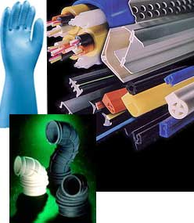
Polymers

Slide 22
Polymers
A polymeric solid can be thought of as a material that contains many chemically bonded parts or units which themselves are bonded together to form a solid.
The word polymer literally means "many parts."
Two industrially important polymeric materials are plastics and elastomers. Plastics are a large and varied group of synthetic materials which are processed by forming or molding into shape.

Slide 23
Polymers
Just as there are many types of metals such as aluminium and copper, there are many types of plastics, such as polyethylene and nylon.
Elastomers or rubbers can be elastically deformed a large amount when a force is applied to them and can return to their original shape (or almost) when the force is released.

Slide 24
Polymer Properties
Polymers have many properties that make them attractive to use in certain conditions. Many polymers:
are less dense than metals or ceramics,
resist atmospheric and other forms of corrosion,
offer good compatibility with human tissue, or
exhibit excellent resistance to the conduction of electrical current.

Slide 25
Polymer Types
The polymer plastics can be divided into two classes, thermoplastics and thermosetting plastics.
This depends on how they are structurally and chemically bonded.
Thermoplastic polymers comprise of the four most important commodity materials – polyethylene, polypropylene, polystyrene and polyvinyl chloride.
There are also a number of specialized engineering polymers. The term ‘thermoplastic’ indicates that these materials melt on heating and may be processed by a variety of molding and extrusion techniques.

Slide 26
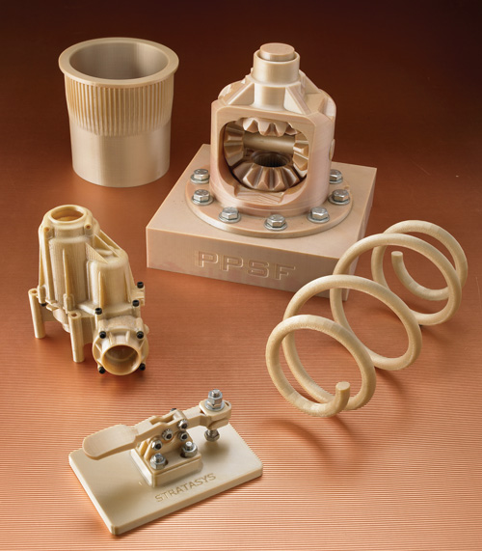
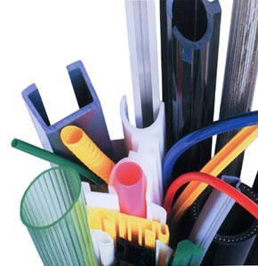
Thermoplastic Examples

Slide 27
Thermoplastic Examples

Slide 28
Thermosetting Polymers
Thermosetting polymers can not be melted or remelted.
Thermosetting polymers include alkyds, amino and phenolic resins, epoxies, polyurethanes, and unsaturated polyesters.
Phenol-formaldehyde, melamine-formaldehyde & urea-formaldehyde.

Slide 29
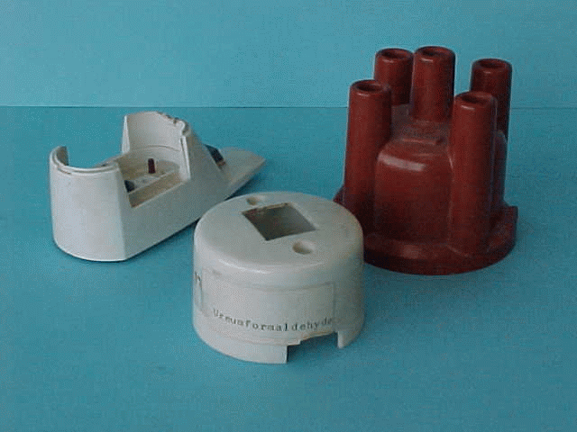
Thermosetting Polymer Examples

Slide 30
Polymers (contd.)
Rubber is a naturally occurring polymer.
However, most polymers are created by engineering the combination of hydrogen and carbon atoms and the arrangement of the chains they form.
The polymer molecule is a long chain of covalent-bonded atoms and secondary bonds then hold groups of polymer chains together to form the polymeric material.
Polymers are primarily produced from petroleum or natural gas raw products but the use of organic substances is growing.
The super-material known as Kevlar is a man-made polymer. Kevlar is used in bullet-proof vests, strong/lightweight frames, and underwater cables that are 20 times stronger than steel.

Slide 31
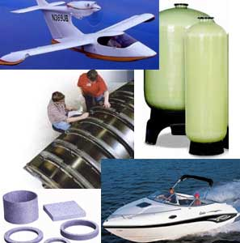
Composites

Slide 32
Composites
A composite is commonly defined as a combination of two or more distinct materials, each of which retains its own distinctive properties, to create a new material with properties that cannot be achieved by any of the components acting alone.
Using this definition, it can be determined that a wide range of engineering materials fall into this category.
For example, concrete is a composite because it is a mixture of cement and aggregate.
Fiberglass sheet is a composite since it is made of glass fibers imbedded in a polymer.

Slide 33
Composites
Composite materials are said to have two phases.
The reinforcing phase is the fibres, sheets, or particles that are embedded in the matrix phase.
The reinforcing material and the matrix material can be metal, ceramic, or polymer.
Typically, reinforcing materials are strong with low densities while the matrix is usually a ductile, or tough, material.

Slide 34
Composite Classifications
Reinforced plastics
Metal-matrix composites
Ceramic-matrix composites
Sandwich structures
Concrete

Slide 35
Composite Forms
Composite materials can take many forms but they can be separated into three categories based on the strengthening mechanism.
These categories are dispersion strengthened, particle reinforced and fibre reinforced.
Dispersion strengthened composites have a fine distribution of secondary particles in the matrix of the material.
These particles impede the mechanisms that allow a material to deform.

Slide 36
Composite Forms (contd.)
These mechanisms include dislocation movement and slip.
Many metal-matrix composites would fall into the dispersion strengthened composite category.
Particle reinforced composites have a large volume fraction of particle dispersed in the matrix and the load is shared by the particles and the matrix.
Most commercial ceramics and many filled polymers are particle-reinforced composites.
In fibre-reinforced composites, the fibre is the primary load-bearing component. Fibreglass and carbon fibre composites are examples of fibre-reinforced composites.

Slide 37
Composite Summary
If the composite is designed and fabricated correctly, it combines the strength of the reinforcement with the toughness of the matrix to achieve a combination of desirable properties not available in any single conventional material.
Some composites also offer the advantage of being “tailorable” so that properties, such as strength and stiffness, can easily be changed by changing amount or orientation of the reinforcement material.
The downside is that such composites are often more expensive than conventional materials

