Slide 1
Atomic Structure
The Atom

Slide 2
What is the Atom?
Atoms are the basic building blocks of matter that make up everyday objects. A desk, the air, even you are made up of atoms!
Atoms are composed of particles called PROTONS, ELECTRONS and NEUTRONS.

Slide 3
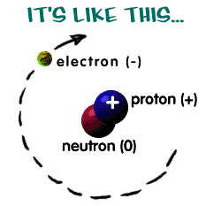
Atom Composition

Slide 4
Atomic Particles
Electrons are tiny, very light particles that have a negative electrical charge.
Protons are much larger and heavier than electrons and have the opposite charge, protons have a positive charge.
Neutrons are large and heavy like protons, however neutrons have no electrical charge.

Slide 5
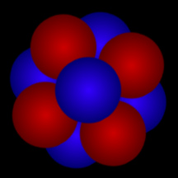
Nucleus of Atom
Although the nucleus of an atom is far too small for us to see, here's one way of thinking about an atomic nucleus: as a cluster of tightly packed "balls". The red "balls" represent protons; the blue "balls" represent neutrons

Slide 6
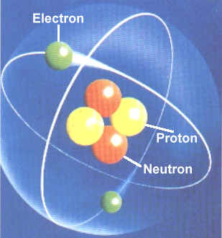
Orbiting Electrons.

Slide 7
Video Explaination
http://www.youtube.com/watch?v=h6LPAwAmnCQ&spfreload=10%20Message%3A%20Syntax%20error%20(url%3A%20http%3A%2F%2Fwww.youtube.com%2Fwatch%3Fv%3Dh6LPAwAmnCQ)

Slide 8
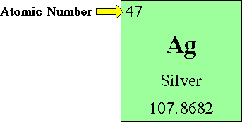
Atomic Numbers.
The atomic number is equal to the number of PROTONS in an atom's NUCLEUS. The atomic number determines which element an atom is. For example, any atom that contains exactly 47 protons in its nucleus is an atom of silver.

Slide 9
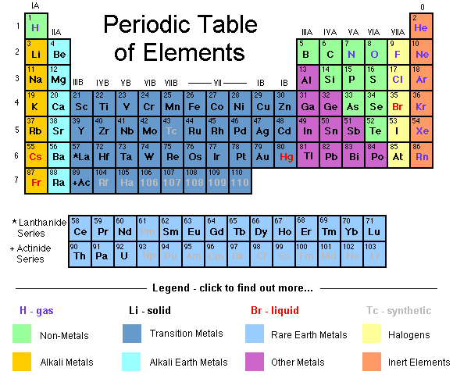
Periodic Table.

Slide 10
Today’s Lesson
Create a PowerPoint that describe the structure and atomic structure for the following:
Sodium (Na)
Polyethylene
Diamond
Glass- reinforced plastic (GRP) / Fibre Glass
Piezoelectric material
Graphite

Slide 11
Chemical Bonding.
Where two or more elements have bonded together.
Water – Hydrogen & Oxygen
Salt – Sodium & Chloride
Water is where 2 atoms of Hydrogen have bonded with 1 atom of Oxygen

Slide 12
Chemical Bonds.
Salt is where one atom of Sodium has bonded with one atom of Chloride
By bonding together this gives the molecules different chemical characteristics to the parent elements.
Sodium is a metal that will ignite violently into flames when coming into contact with water due to the Hydrogen gas produced.
Chlorine is a highly toxic gas, greenish in colour.

Slide 13
Why Do Chemicals Bond?
Chemical bonds form to lower the energy of the system.
The components of the system become more stable through the formation of bonds.
Everything wants to be more stable - its easier to lie down than stand up.
Bonding is Nature's way of allowing the elements to lie down.

Slide 14
Types of Bonding.
Three main types we shall concentrate on are:
Ionic Bonding -which involves the transfer of electron(s).
Covalent Bonding -which involves sharing of electrons.
Metallic Bonding - which in some ways can be considered as a combination of both.

Slide 15
Ionic Bonding.
Ionic compounds are generally solids at room temperature and have high melting and boiling points.
They are hard but brittle solids and are poor conductors of electricity in the solid state (good conductors when molten or in solution).
Ionic bonds are "strong" and omnidirectional.
See handout.

Slide 16
Covalent Bonding.
A chemical bond formed by the sharing of one or more electrons, especially pairs of electrons, between atoms.
In this way, both atoms share the stability of a full valence shell.
This most commonly occurs when two non-metals bond together.
See handout.

Slide 17
Metallic Bonding.
Force of attraction operating in a metal that holds the atoms together in a metallic structure.
In metallic bonding, metal atoms form a close-packed, regular arrangement.
The atoms lose their outer-shell electrons to become positive ions.
The outer electrons become a ‘sea’ of mobile electrons surrounding a lattice of positive ions.
The lattice is held together by the strong attractive forces between the mobile electrons and the positive ions.
See Handout.

