Slide 1
Material Classification
Wk 3
Ceramics

Slide 2
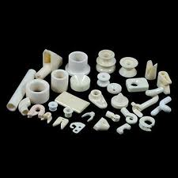
Ceramics

Slide 3
Ceramics
Ceramic materials have had a long history in the electrical industry due to their high electrical resistance but have now assumed considerable importance in a variety of industrial applications.

Slide 4
Ceramics
Properties attractive to industrial applications such as the ability to withstand high temperatures – refractories and refractory coatings and hard wearing coated cutting tools.

Slide 5
Ceramics
In general ceramics are hard, brittle, high melting – point materials with low electrical and thermal conductivity.
They have low thermal expansion, good chemical and thermal stability including good creep resistance and high compressive strength.

Slide 6
Ceramics
Ceramic materials are compounds of metallic and non-metallic elements often in the form of oxides, carbides and nitrides and exist in a wide variety of compositions and forms.

Slide 7
Ceramics
Oxide - is a chemical compound that contains at least one oxygen atom in its chemical formula.
Carbide - is a compound composed of carbon.
Nitride - is a compound of nitrogen. Nitrides are a large class of compounds with a wide range of properties and applications.

Slide 8
Ceramics
As in metals ceramic materials can exist in more than one structural arrangement.
They can also be arranged in forms of chains similar to plastics and polymers etc.
Many ceramics are Silica based composing of a crystalline structure.

Slide 9
Ceramics
Ceramics can also exist in a non crystalline structure in a solid form. This amorphous condition is referred to as the glassy state and the subsequent materials are known as glasses.

Slide 10
Ceramics
By cooling rapidly to a rigid condition without allowing for crystallizing or a definitive structure to form this determines an amorphous solid. (Glass)
Glass ceramics can be modified by heat treatment to assist in forming a crystalline structure within the amorphous base.

Slide 11
Ceramics
The crystalline structure assists in helping retard creep at high temperatures. (We will cover creep later in the course).
Strength is greater than normal glass and it provides greater resistivity to thermal shock.

Slide 12
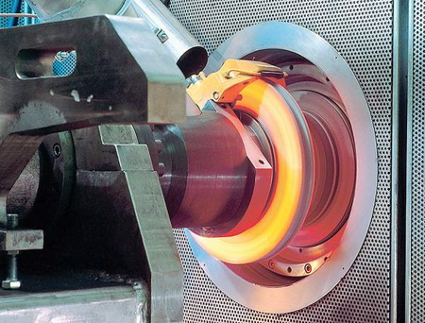
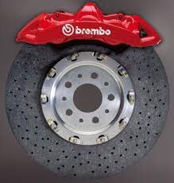
Ceramics

Slide 13

Ceramics
Engineered ceramics are increasingly being used in commercial and military aircraft, and have been used in the space shuttle and its equipment for many years.

Slide 14
Ceramics.
Ceramic applications include thermal protection systems in rocket exhaust cones, insulating tiles for the space shuttle, engine components, and ceramic coatings that are embedded into the windshield glass of many airplanes. These coatings are transparent and conduct electricity for keeping the glass clear from fog and ice

Slide 15
Ceramics
Ceramic fibres are used as heat shields for fire protection and thermal insulation in aircraft and space shuttles because they resist heat, are lightweight and do not corrode. Other significant characteristics include high melting temperatures, resiliency, tensile strength and chemical inertness.

Slide 16
Ceramics
A non-oxide ceramic called silicon nitride has excellent high temperature strength, excellent fracture toughness and a high hardness capability.

Slide 17
Ceramics
Silicon nitride aerospace applications result in superior mechanical reliability and wear resistance allowing components to be used under minimal lubrication without wear. These include jet engine igniters, bearings, bushings, and other wear components.

Slide 18
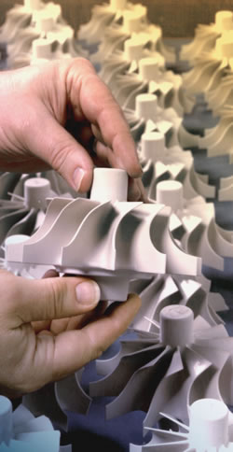
Ceramics.
Ceramic materials developed for gas turbine rotors are used in aircraft and diesel engine parts.

