Slide 1
Smart Materials

Slide 2
Shape Memory Alloys
Smart materials or their correct terminology shape memory alloys are materials that "remember" their original shape and return to it when heated.

Slide 3
Shape Memory Alloys
The original shape can be set easily by heat treatment. These alloys are used in orthopedic implants and other medical applications, as well as in air conditioners and other home appliances, automobiles, etc.

Slide 4
Shape Memory Alloys
The most widely used shape memory material is an alloy of Nickel and Titanium called Nitinol.

Slide 5
Shape Memory Alloys
The shape memory effect is caused by a temperature dependent crystal structure.
When an SMA is below its phase transformation temperature, it possesses a low yield strength crystallography referred to as Martensite.

Slide 6
Shape Memory Alloys
While in this state, the material can be deformed into other shapes with relatively little force.
The new shape is retained provided the material is kept below its transformation
temperature.

Slide 7
Shape Memory Alloys
When heated above this transformation temperature, the material reverts to its parent structure known as Austenite causing it to return to its original shape.

Slide 8
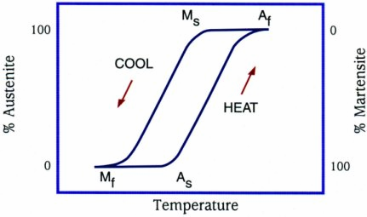
Phase Transformation

Slide 9
Austenite.
The high temperature causes the atoms to arrange themselves into high symmetry, often cubic arrangement known as the austenite phase.
Whilst in this state the crystal structure is in a Face Centre Cubic formation.

Slide 10
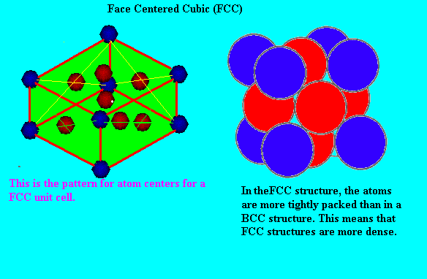
Austenite Structure.

Slide 11
Martensite.
Whilst in this state the crystal structure is in a Body Centre Cubic formation.

Slide 12
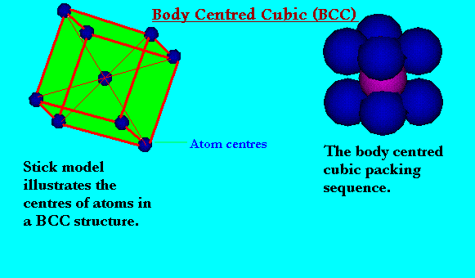
Martensite Structure.

Slide 13
Smart Fluids
These are fluids whose properties can be altered by applying a magnetic or electric field.
So far, the most useful of these materials alter their viscosity in an applied electric or magnetic field.

Slide 14
Smart Fluids
The current model of the Audi TT uses a smart fluid in its suspension. These fluids have also been used as earthquake shock absorbers in some buildings in Japan.

Slide 15
Smart Fluids
A magneto- rheostatic fluid is a smart fluid containing microscopic magnetic particles suspended in a carrier fluid that is usually a type of oil. When subjected to a magnetic field the viscosity of the fluid increases to the point where it virtually becomes a solid.

Slide 16
Smart Fluids
It is then said to be in its “on” state where the magnetic particles align themselves along the lines of magnetic flux greatly restricting the movement of the fluid.

Slide 17
Smart Fluids
Provided enough force is applied, the material will shear and by magnetic field strength can control the yield point at which this occurs. Magneto-rheostatic fluids have found applications in fast acting fluid clutches, brakes, shock absorbers and flow control valves.

