Slide 1
Ferrous Metallurgy:
The Chemistry and Structure of Iron and Steel

Slide 2
Pure Iron
Iron from which the residual carbon left over from smelting has been removed.
In the pure state it is a very soft grey metal
Of no commercial use

Slide 3
Wrought Iron
Has approx 0.05% carbon
Used since about 2000 BC
Is stronger than most other pure metals.
Made into weapons, armour, cooking pots and vessels
Main limitation to wider uses due to processing (no way of making large items and no welding)

Slide 4
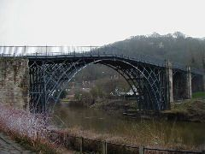
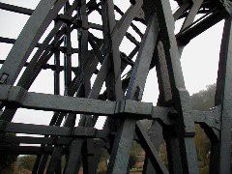
Abraham Darby’s Ironbridge

Slide 5
Cast Iron
Between 2% & 4% carbon content
Standard grey cast iron very brittle due to carbon rosettes in the structure acting as stress-raisers
Possible to use heat treatment to improve the structure, this gives materials such as ductile iron and malleable iron (black heart)

Slide 6
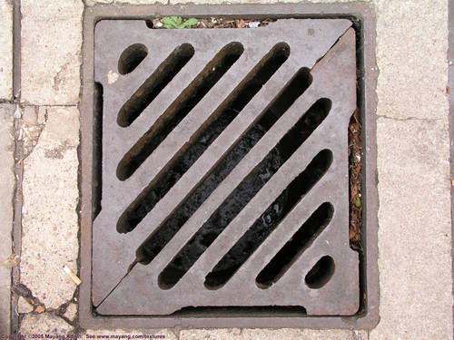
Ductile iron used in drain grids

Slide 7
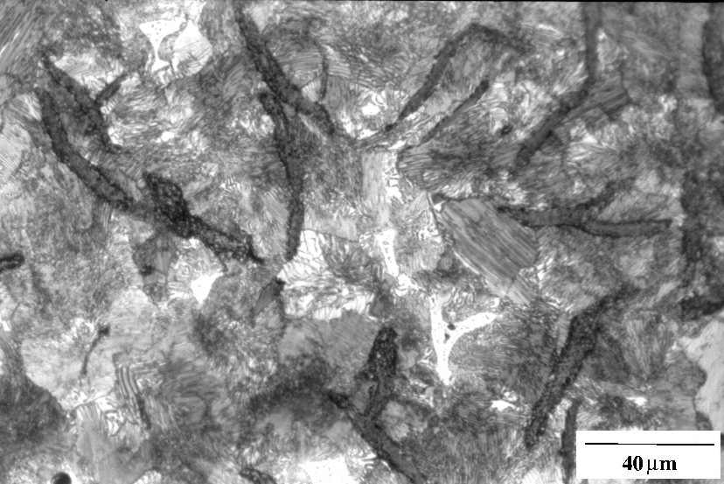
Grey cast iron showing the graphite flakes in a pearlite matrix

Slide 8
Steel
0.001% to 1.5% carbon
Wide range of properties due to:
Variation in carbon content
Cold working
Heat treatment
Addition of alloying elements

Slide 9
Microstructure of Steel
Five main constituents:
Ferrite
Austenite
Cementite
Pearlite
Martensite

Slide 10
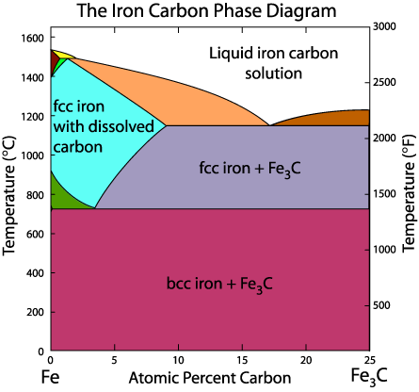

Slide 11
Ferrite
The structure of pure iron.
Has a body-centred cubic (BCC) crystal structure. It is soft and ductile and imparts these properties to the steel. Very little carbon (less than 0.01% carbon will dissolve in ferrite at room temperature).

Slide 12
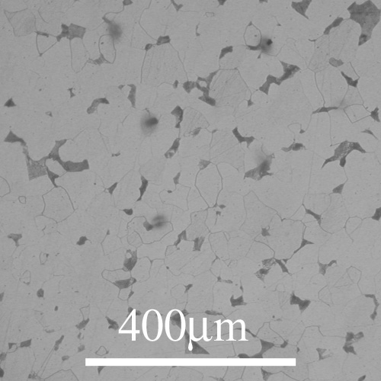
A photomicrograph of 0.1% carbon steel (mild steel). The light areas are ferrite.

Slide 13
Austenite
This is the structure of iron at high temperatures (over 912 deg C).
Has a face-centre cubic (FCC) crystal structure. This material is important in that it is the structure from which other structures are formed when the material cools from an elevated temperature. Not present at room temperatures.

Slide 14
Cementite
A compound of iron and carbon, iron carbide (Fe3C).
It is hard and brittle and its presence in steels causes an increase in hardness and a reduction in ductility and toughness.

Slide 15
Pearlite
A laminated structure formed of alternate layers of ferrite and cementite.
It combines the hardness and strength of cementite with the ductility of ferrite and is the key to the wide range of the properties of steels. The laminar structure also acts as a barrier to crack movement as in composites. This gives it toughness.

Slide 16
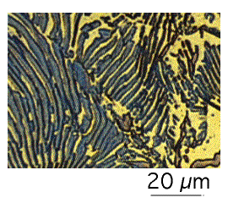
Two-dimensional view of pearlite, consisting of alternating layers of cementite and ferrite.

Slide 17
Martensite
A very hard needle-like structure of iron and carbon.
Only formed by very rapid cooling from the austenitic structure (i.e. above upper critical temperature). Needs to be modified by tempering before acceptable properties reached.

Slide 18
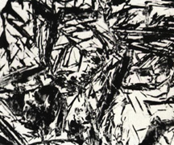
The needle-like structure of martensite, the white areas are retained austenite.

Slide 19
Carbon
In steels none of the carbon is present as free carbon. It is all dissolved in the iron as part of the previously described structures.

Slide 20
0.1% Carbon Steel
Note the small amount of pearlite in the structure

Slide 21
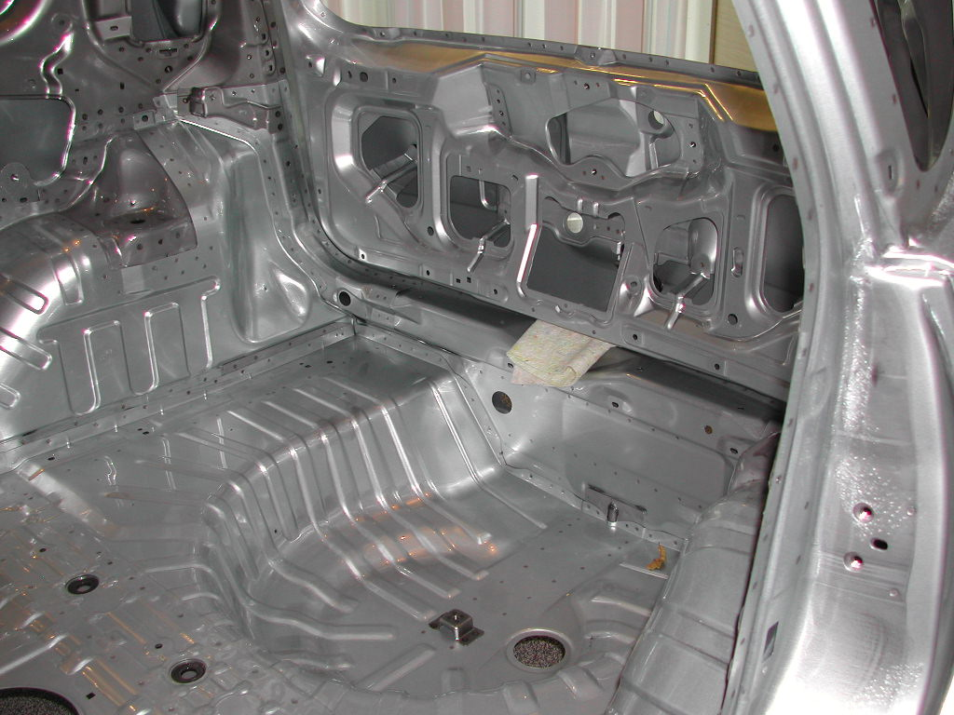
Applications
A typical application of low carbon steel in a car body.

Slide 22
Effect of Carbon Content
Increasing the carbon content decreases the amount of ferrite and increases the proportion of pearlite in the structure.

Slide 23
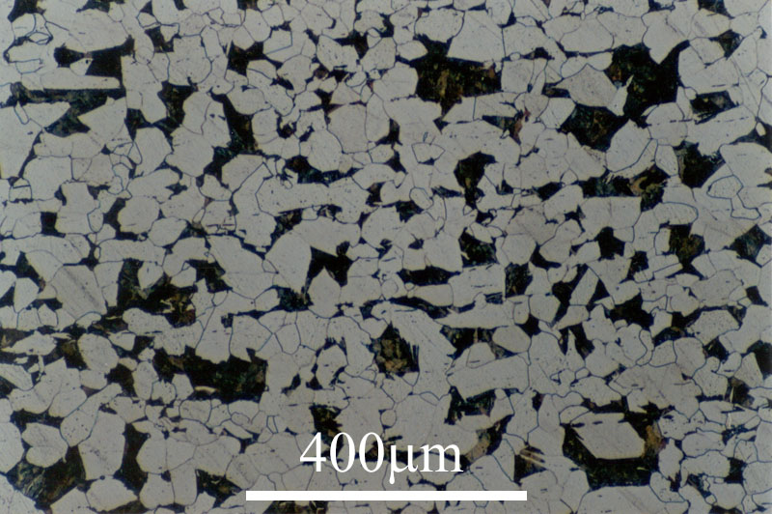
0.2% Carbon Steel
Note the increased amount of pearlite compared with the 0.1% ‘dead mild’ steel

Slide 24
Eutectic Structure
This leads to an increase in strength and hardness and a reduction in ductility.
This continues until there is 0.8% carbon at which point the structure is 100% pearlite. This is known as a eutectic structure.

Slide 25
Over 0.8% Carbon
As carbon content increases beyond 0.8%, no more pearlite can be formed.
The excess carbon forms cementite which is deposited in between the pearlite grains. This increases the hardness, but slightly reduces the strength. The ductility of all plain carbon steels over 0.8% carbon is very low.

Slide 26
Properties of Carbon Steels
Carbon content wt % | Properties | Applications
0.01 - 0.1 | Soft, ductile, no useful hardening by heat treatment except by normalizing, but can be work-hardened. Weldable. | Pressings where high formability required
0.1 - 0.25 | Strong, ductile, no useful hardening by heat treatment except by normalizing, but can be work-hardened. Weldable. Ductile-brittle transition temperature is just below room temperature | General engineering uses for a mild steel
0.25 - 0.6 | Very strong, heat treatable to produce a wide range of properties in quenched and tempered conditions. Difficult to weld. Can become brittle below room temperature. | Bars and forgings for a wide range of engineering components. Connecting rods, springs, hammers, axle shafts requiring strength and toughness.

Slide 27
Properties of Carbon Steels
Carbon content wt % | Properties | Applications
0.6 - 0.9 | Strong, whether heat treated or not. Ductility lower when less carbon is present | Used where maximum strength rather than toughness is important. Tools, wear resisting components ( piano wire and silver steels are in this group).
0.9 - 2.0 | Wear resistant and can be made very hard at expense of toughness and ductility. Cannot be welded. Tend to be brittle if the structure is not carefully controlled | Cutting tools like wood chisels, files, saw blades.

