Slide 1
Transformers
Single Wound Autotransformer
Double wound and Isolating

Slide 2
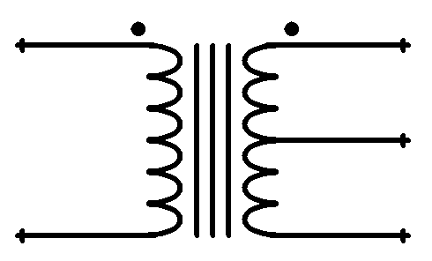
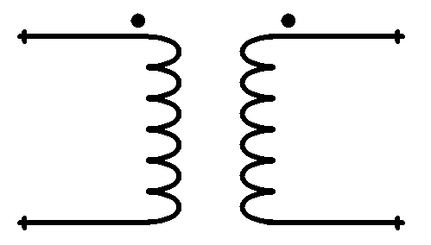
Electromagnetic flux passes energy between windings when it changes – only when it changes
The dots denote phase
Air cored transformer that is double wound, and has a single secondary for producing a wide range of voltage changes – usually higher frequencies
Iron cored transformer that is double wound, and has a tapped secondary for producing a wide range of voltage changes

Slide 3
Double Wound or Isolating….
The double wound transformer has primary and secondary windings coupled only by the changing magnetic field. There is no electrical coupling and the secondary voltage is only between the secondary connections. There is no voltage between earth and the secondary which makes the isolating transformer safe to use in earthed areas.
Ordinarily the frame of a double wound transformer is connected to earth – equipotential bonding – but then its not an isolating transformer.

Slide 4
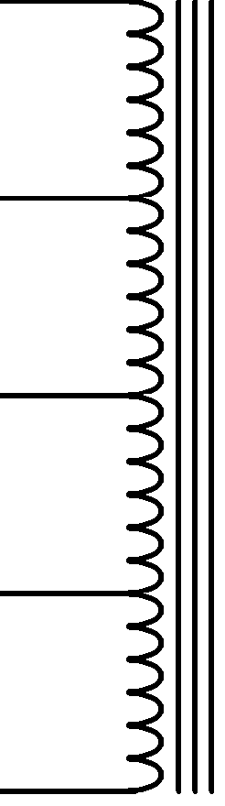
The autotransformer
Secondary
Here we have a transformer with only one coil/winding, it still has a laminated iron former but the secondaries are all on the same piece of wire as the primary. Typically this transformer will half the weight and about a third of the cost of a double wound.
The problem with this sort of transformer is the range of output voltage – the primary is part of the secondary so if we try to create a large voltage difference then the magnetic flux has to travel a greater distance – this limits these transformers to about ½ to double voltages.
They are ideal for small changes, say 400 to 415 as might be required in voltage regulation.
Secondary
Secondary
PRIMARY

Slide 5
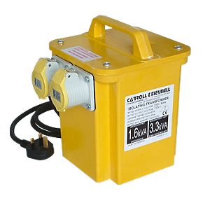
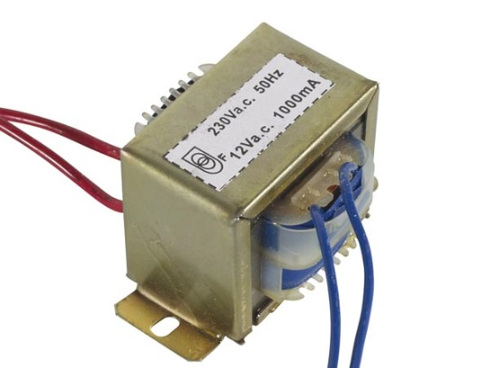
Nice Little Transformers

Slide 6
We use the transformers to change voltage and current for safety and economy… High voltages give lower I²R losses but are dangerous. In the home we can allow 240V and in the US they use only 110V. Shops and offices where more power is required use three phase electricity (415V) and industry uses it at even higher voltages…

Slide 7
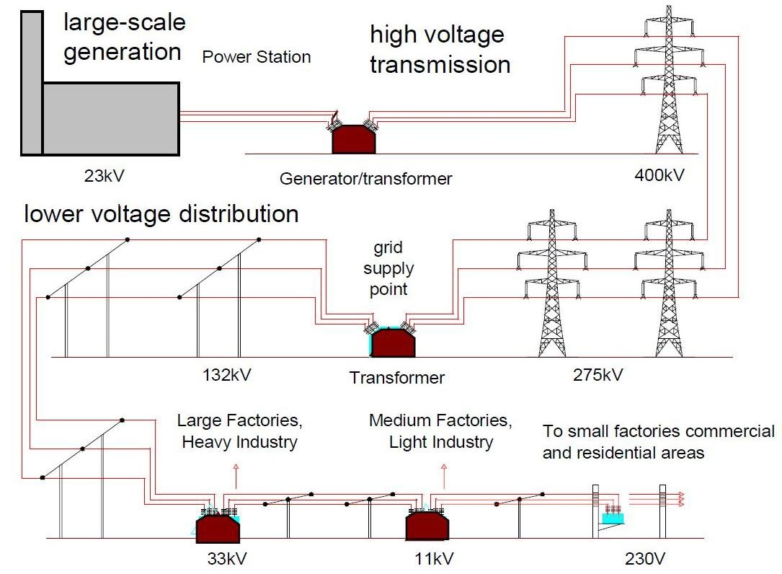
We use the bigger transformers to change voltages on the National Grid or bulk electricity distribution systems
Question: why use such high voltages?
Answer: think about V=IR, P=IV

Slide 8
We found out that air will break down at about 1000 V per millimetre – so at 475kV the arc could be 475mm – but in damp air it will be much more. We need to add a factor for safety – or maybe use a different insulator – oil is good – maybe a vacuum or some other insulators, glass, PVC, ceramic, etc…

Slide 9
What about the switches? We need to be as far distant as possible for our own safety and the contacts will need to move really fast – preferably when the voltage is lowest – when the sine wave goes through the 0V – we call that a “zero crossing switch” but a 50th of a second later the contacts need to be over half a metre away!

Slide 10
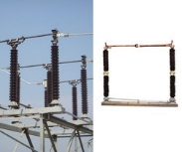
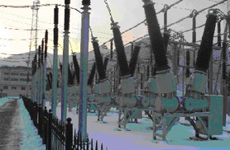
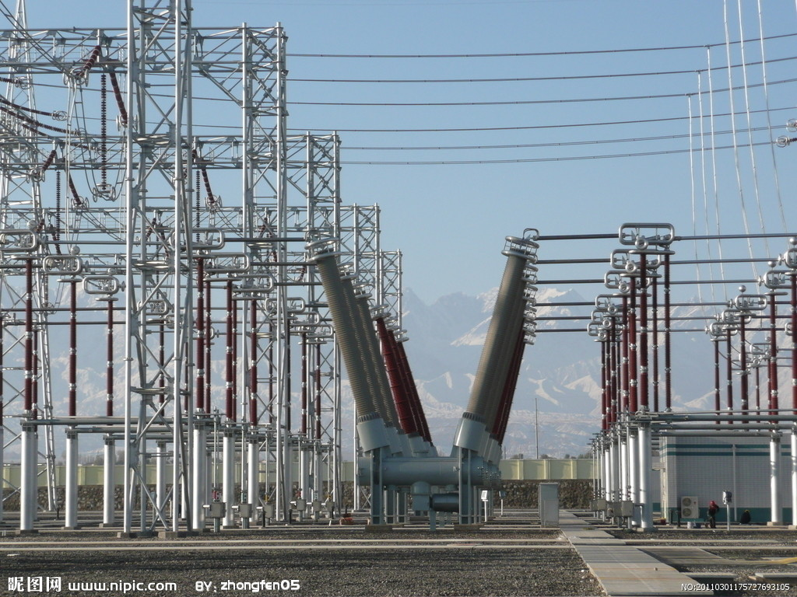
Some Switches… Air is the insulator

Slide 11
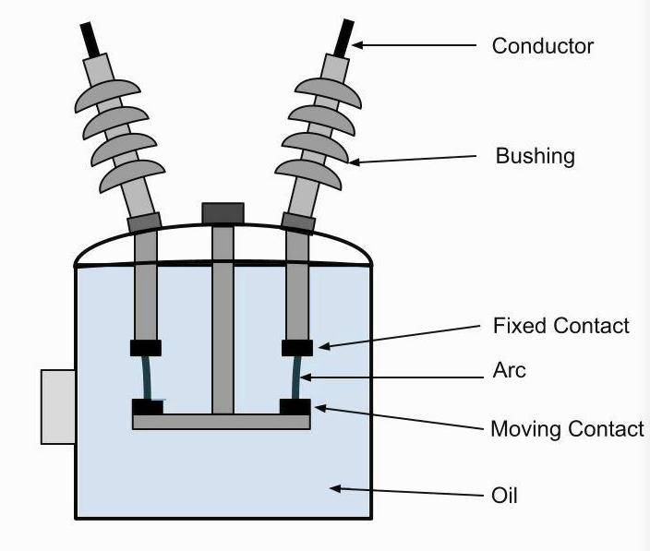
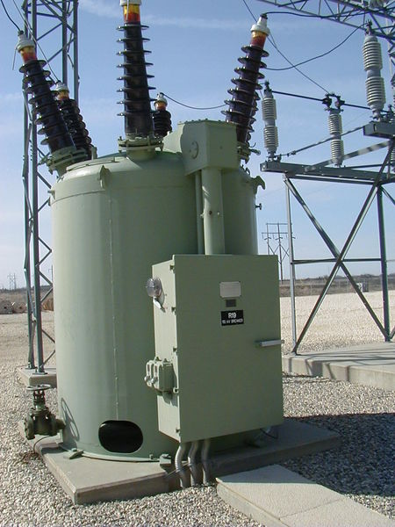
Oil circuit breaker in section

Slide 12
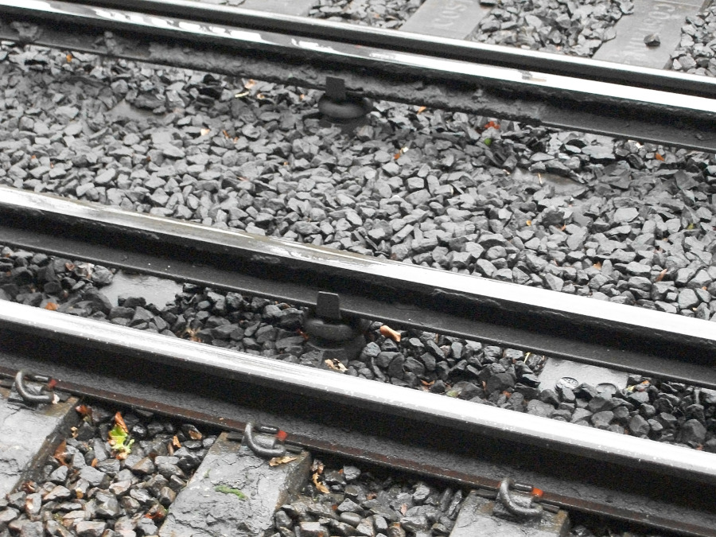
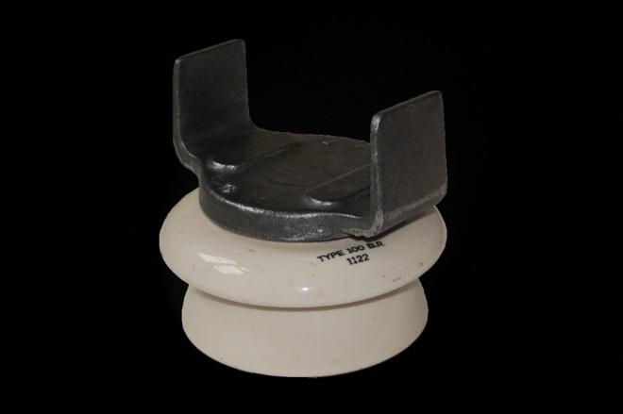
Ceramic is used for heavy weight bearing insulators….

Slide 13
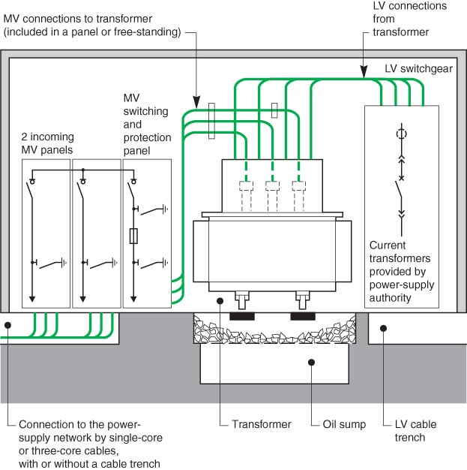
A Rough layout of a street level transformer sub station. The regulations specify depths for trenches and distance between operators and HV lines, etc…

