Slide 1
Magnets
Some notes on the magnetic properties of materials

Slide 2
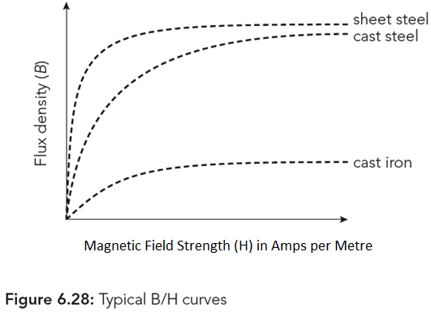
Magnetic Properties of Materials
Notes:
In order to turn a neutral magnetic material into a magnet we must add some force; from another magnet or using electricity. The electric method involves passing direct current (DC) through an insulated conductor wrapped around the material. The turns around the bar is called a coil. The bar and the wire together is called a solenoid.
Increasing the current through that coil gives an increase in the magnetic field strength (H) which we call amps per metre or amp turns (AT).
The graphic shows how magnetic flux density (B) builds and saturates in three different ferrous materials, the flux density is specified in Teslas.

Slide 3
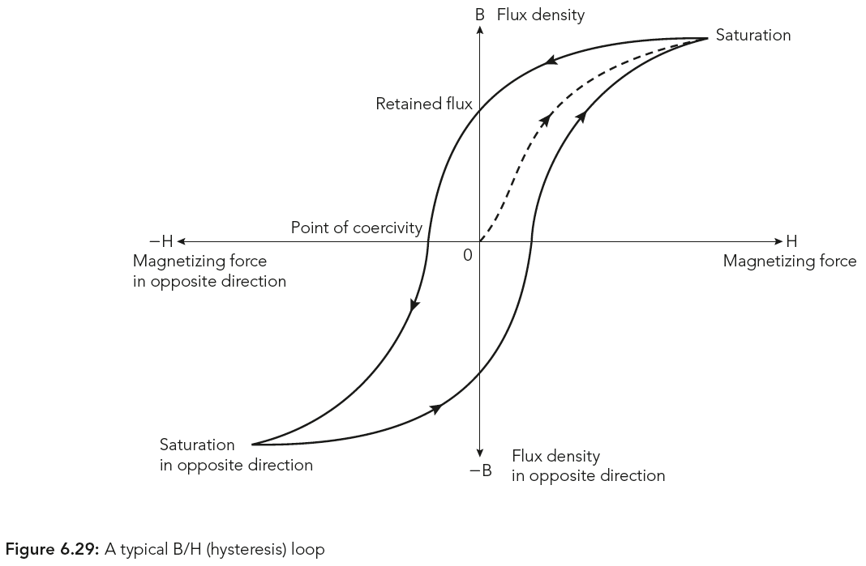
Nomenclature
Notes:
Starting from zero (0) the magnetising force (H) is increased until the material is saturated by magnetism (B), the force is then reversed. From the curve we see that as the force reaches zero some flux is retained. The material does not return to neutral (B=0) until a negative (coercive) force is applied. The ideal magnet for AC, transformers, inductors, solenoids, etc., would be a straight line with no coercivity or retentivity.

Slide 4
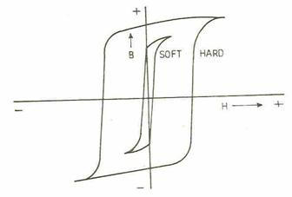
Indicate coercivity and retentivity on this diagram…
Notes:
Materials with hard magnetic properties retain their magnetism and require a lot of energy to change them – they need to be coerced into neutrality; soft magnets lose their magnetism when the magnetising energy is removed.

Slide 5
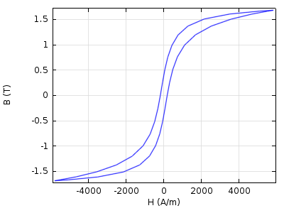
Hard or Soft
Notes:
At about 2000 A/m this material starts to saturate – not ideal – but the low coercivity is particularly good.

Slide 6
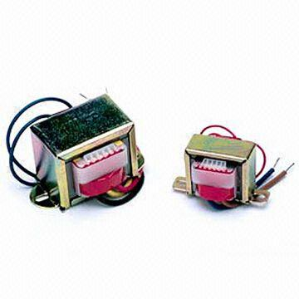
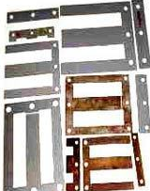
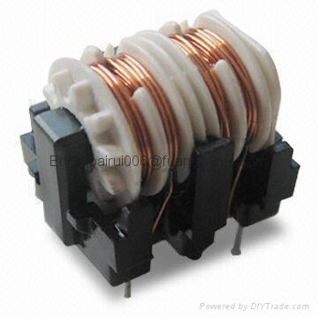
Ferrite Magnet Material
Laminates reduce the induced eddy currents by making the length (l) in E=Blv small
Transformers with laminated iron formers
40kHz
100Watt ferrite transformer
50 Hz Transformers made with laminated cores; thin sheets of transformer (soft) steel capable of changing voltages in 100Watt applications
Notes:
A ferrite is a type of ceramic compound composed of iron oxide (Fe2O3) combined chemically with one or more additional metallic elements.
Hard ferrites have high coercivity, hence they are difficult to demagnetise and are used for loudspeaker magnets, fridge magnets, HDD actuators and the like.
Soft ferrites have low coercivity. They are used in the electronics industry to make ferrite cores for inductors and transformers, the low coercivity means the material's magnetisation can easily reverse direction without dissipating much energy in hysteresis losses. The material's high resistivity prevents eddy currents being induced by the changing magnetic fields around them, another source of energy loss.

Slide 7
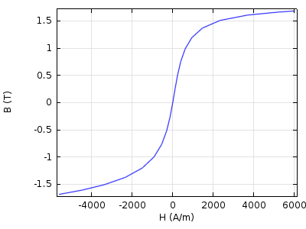
The Ideal – Ferrite – Minute “Iron Loss”

