Slide 1
An Introduction to Ohm’s Law
Welcome
from
Jim Gillain

Slide 2
Nomenclature – The Volt An Introduction to Ohm’s Law
The naming of the principle quantities = nomenclature
In ohms law we will use:
Volt: the unit of electromotive force
Volt: the attractive force between two points (V)
mV: the millivolt V/1000
kV: kilovolt V*1000
Notes:
I really must express the “force” element, it is the volts that push the electrons to flow; positives are attracted to negatives; electrons will try to flow from a high voltage to a low or negative voltage (conventionally).
Volt; the attractive force between two points causing one amp to flow through one ohm at 1 V

Slide 3
The Ampere or Amp An Introduction to Ohm’s Law
In ohms law we will use:
Amps (A) which defines the amount of current (I)
One amp is a flow of one coulomb of charge between nodes in one second
1A * 1V is one Watt (W)
Notes:
Amp: the quantity of electrons passing a point in one second (6.242*10^18 electrons)
Current (I) always finds the path of least resistance
The force causing the movement is work being done so power, one watt, more Voltage or more current represents more poser.

Slide 4
Resistance An Introduction to Ohm’s Law
Resistance is the unit resistance in ohms (Ω)
A conductor will have only partial ohms, mΩ, that’s milliohms; Ω/1000 or less
An insulator will have many MΩ megohms; Ω*10^6
Notes:
Οημ τηε σψμβολ φορ α δεϖιχε ορ χιρχυιτ τηατ ωιλλ προδυχε α ϖολταγε ποτεντιαλ διφφερενχε οφ 1 ϖολτ βετωεεν τωο ποιντσ ωηεν 1 Αμπ ισ φλοωινγ.
Resistors are electronic components used to limit the flow of current

Slide 5
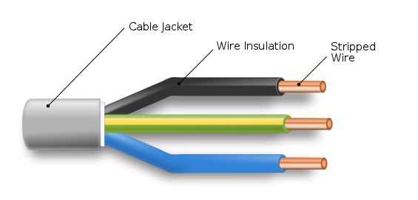
Conductors and Insulators An Introduction to Ohm’s Law
Notes:
Here we see a “mains cable” The stripped wire is copper an element with relatively low resistance, silver is lower but copper is stronger and much less expensive. Aluminium is sometimes used in very high voltage cables because it is less costly but not flexible so not for house wiring.
This wire has two insulators, a coloured insulator to stop current flowing between conductors and an insulating jacket to stop current flowing into anything touching the cable (especially us!)
The thicker the cable the lower its resistance, in house wiring we use 2.5mm^2 for short runs up to 13A or 4mm^2 for double sockets on a radial circuit, but for a longer length of cable we use larger “cross sectional area” as used for an electric cooker, electric shower or similar (9kW) 10mm^2

Slide 6
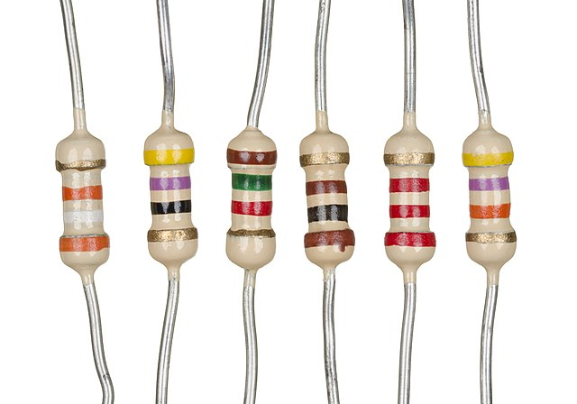
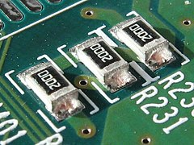
Resistors
Notes:
Resistors can be quite large, physically or even really small – in college we use through hole and they tend to be colour coded so we can read the values; the surface mount types often have their values written on them in text, its very small, we use a digital microscope to see those…

Slide 7
OHMS LAW
Voltage is proportional to the resistance and current
V = I * R
And we can transpose to give:
I = V/R R=V/I

Slide 8
And Finally…
Next time we will look at resistors in series and parallel
Voltages and currents in series an parallel circuits
Notes:
Now complete some exercises with resistors and values given on a worksheet

